Slide 1

Introduce to ReactJS

Slide 2
Content
Installation – prepare the environment
What is React? – JSX, Components, Props and States
A demo on state management and conditional rendering

Slide 3
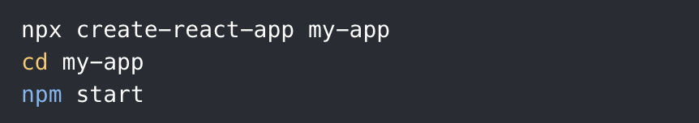
Installation
Install Node.js
Run the following command in the command line:
Demo environment: Linux, MacOS

Slide 4
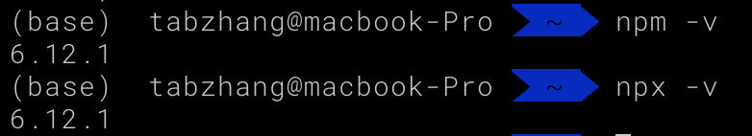
Installation
Install Node.js and check the version

Slide 5
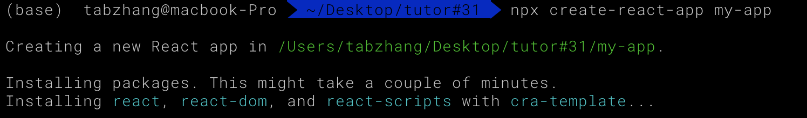
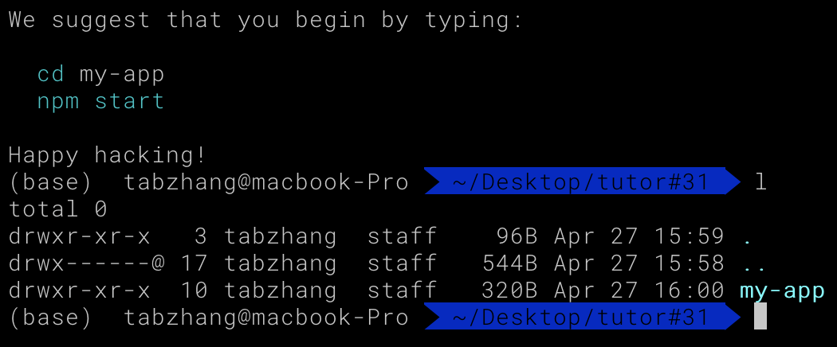
Installation
Create the application

Slide 6

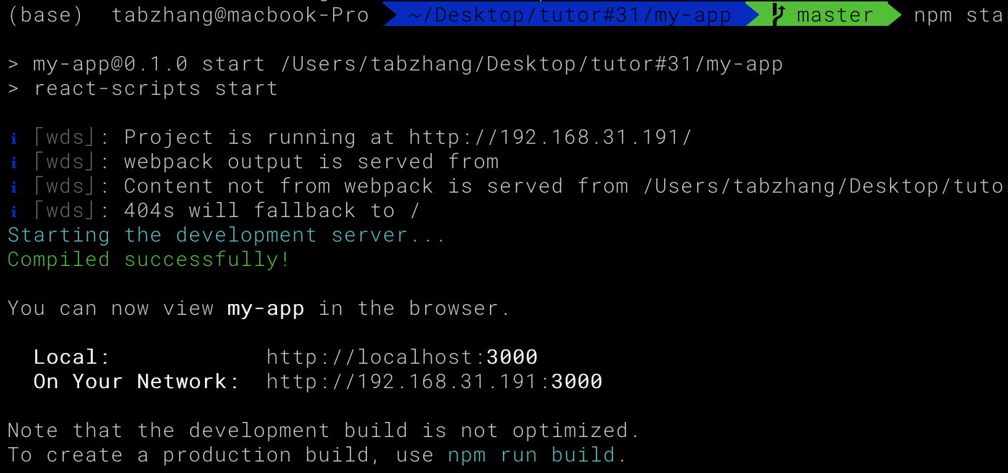
Installation
Run the application

Slide 7
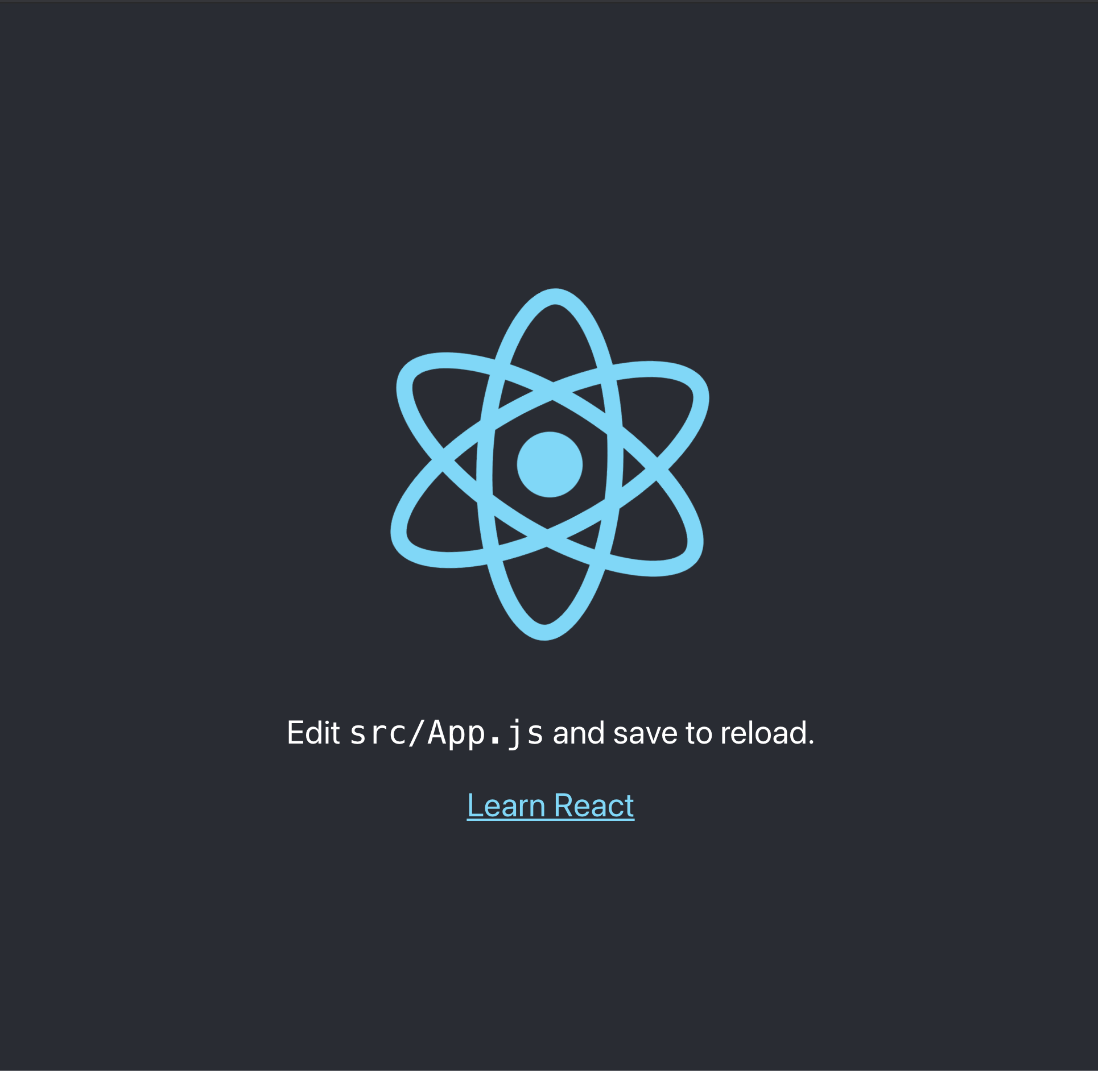
Installation
Run the application

Slide 8
What`s ReactJS?
JSX
Component
Props
States
https://reactjs.org/docs/glossary.html

Slide 9
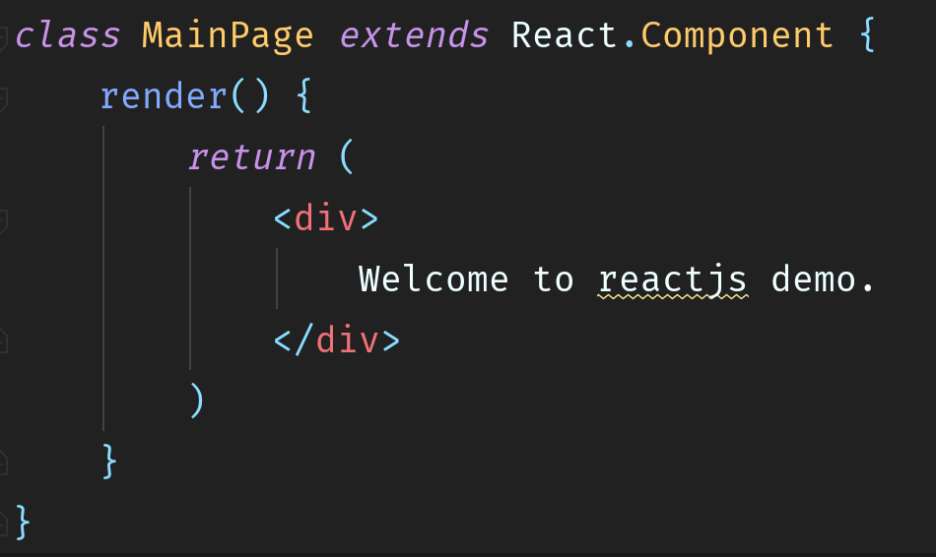
Demo
Open the project with WebStorm (Or use any other text editor or IDE)
Open src/index.js
Create our first component MainPage (every component could be created in such way)

Slide 10
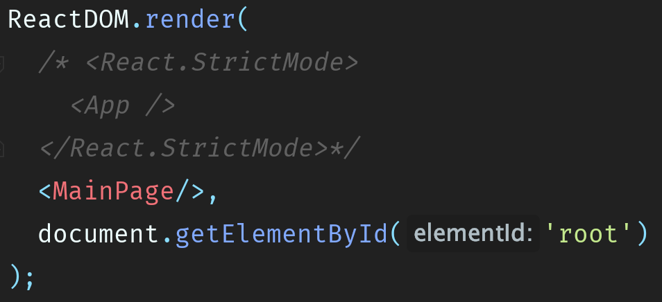
Demo
4. This part of code would render the whole application to the html page, let`s replace the default component with ours.

Slide 11
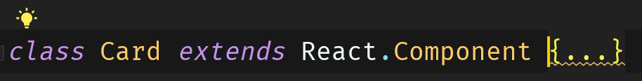
Demo
5. Let`s create a card component with element Bootstrap card
Add bootstrap reference into index.html (just add two lines)
Then create component Card

Slide 12
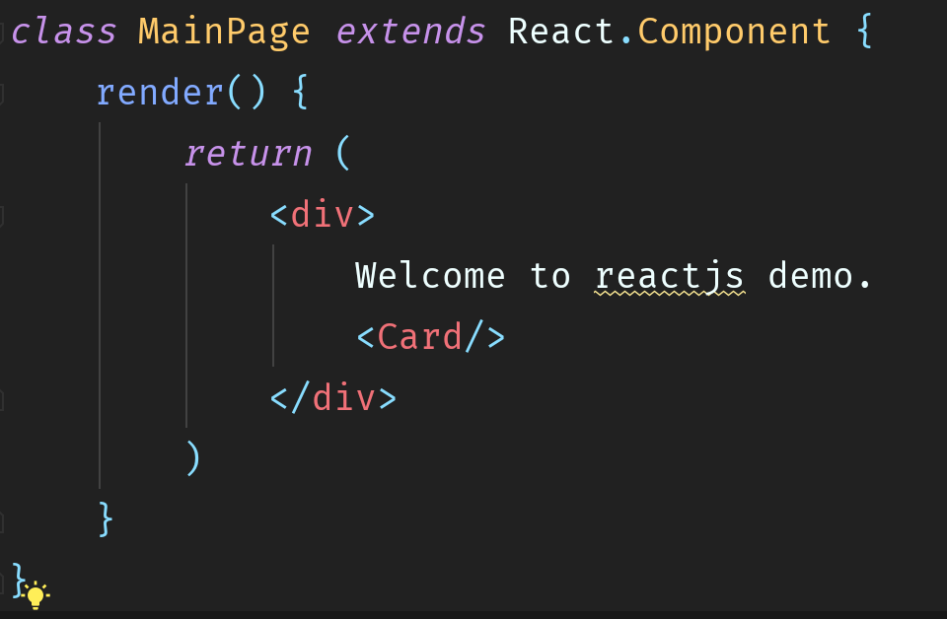
Demo
6. We could render the card into the main page by simply adding Card component
Into the render function of the Mainpage

Slide 13
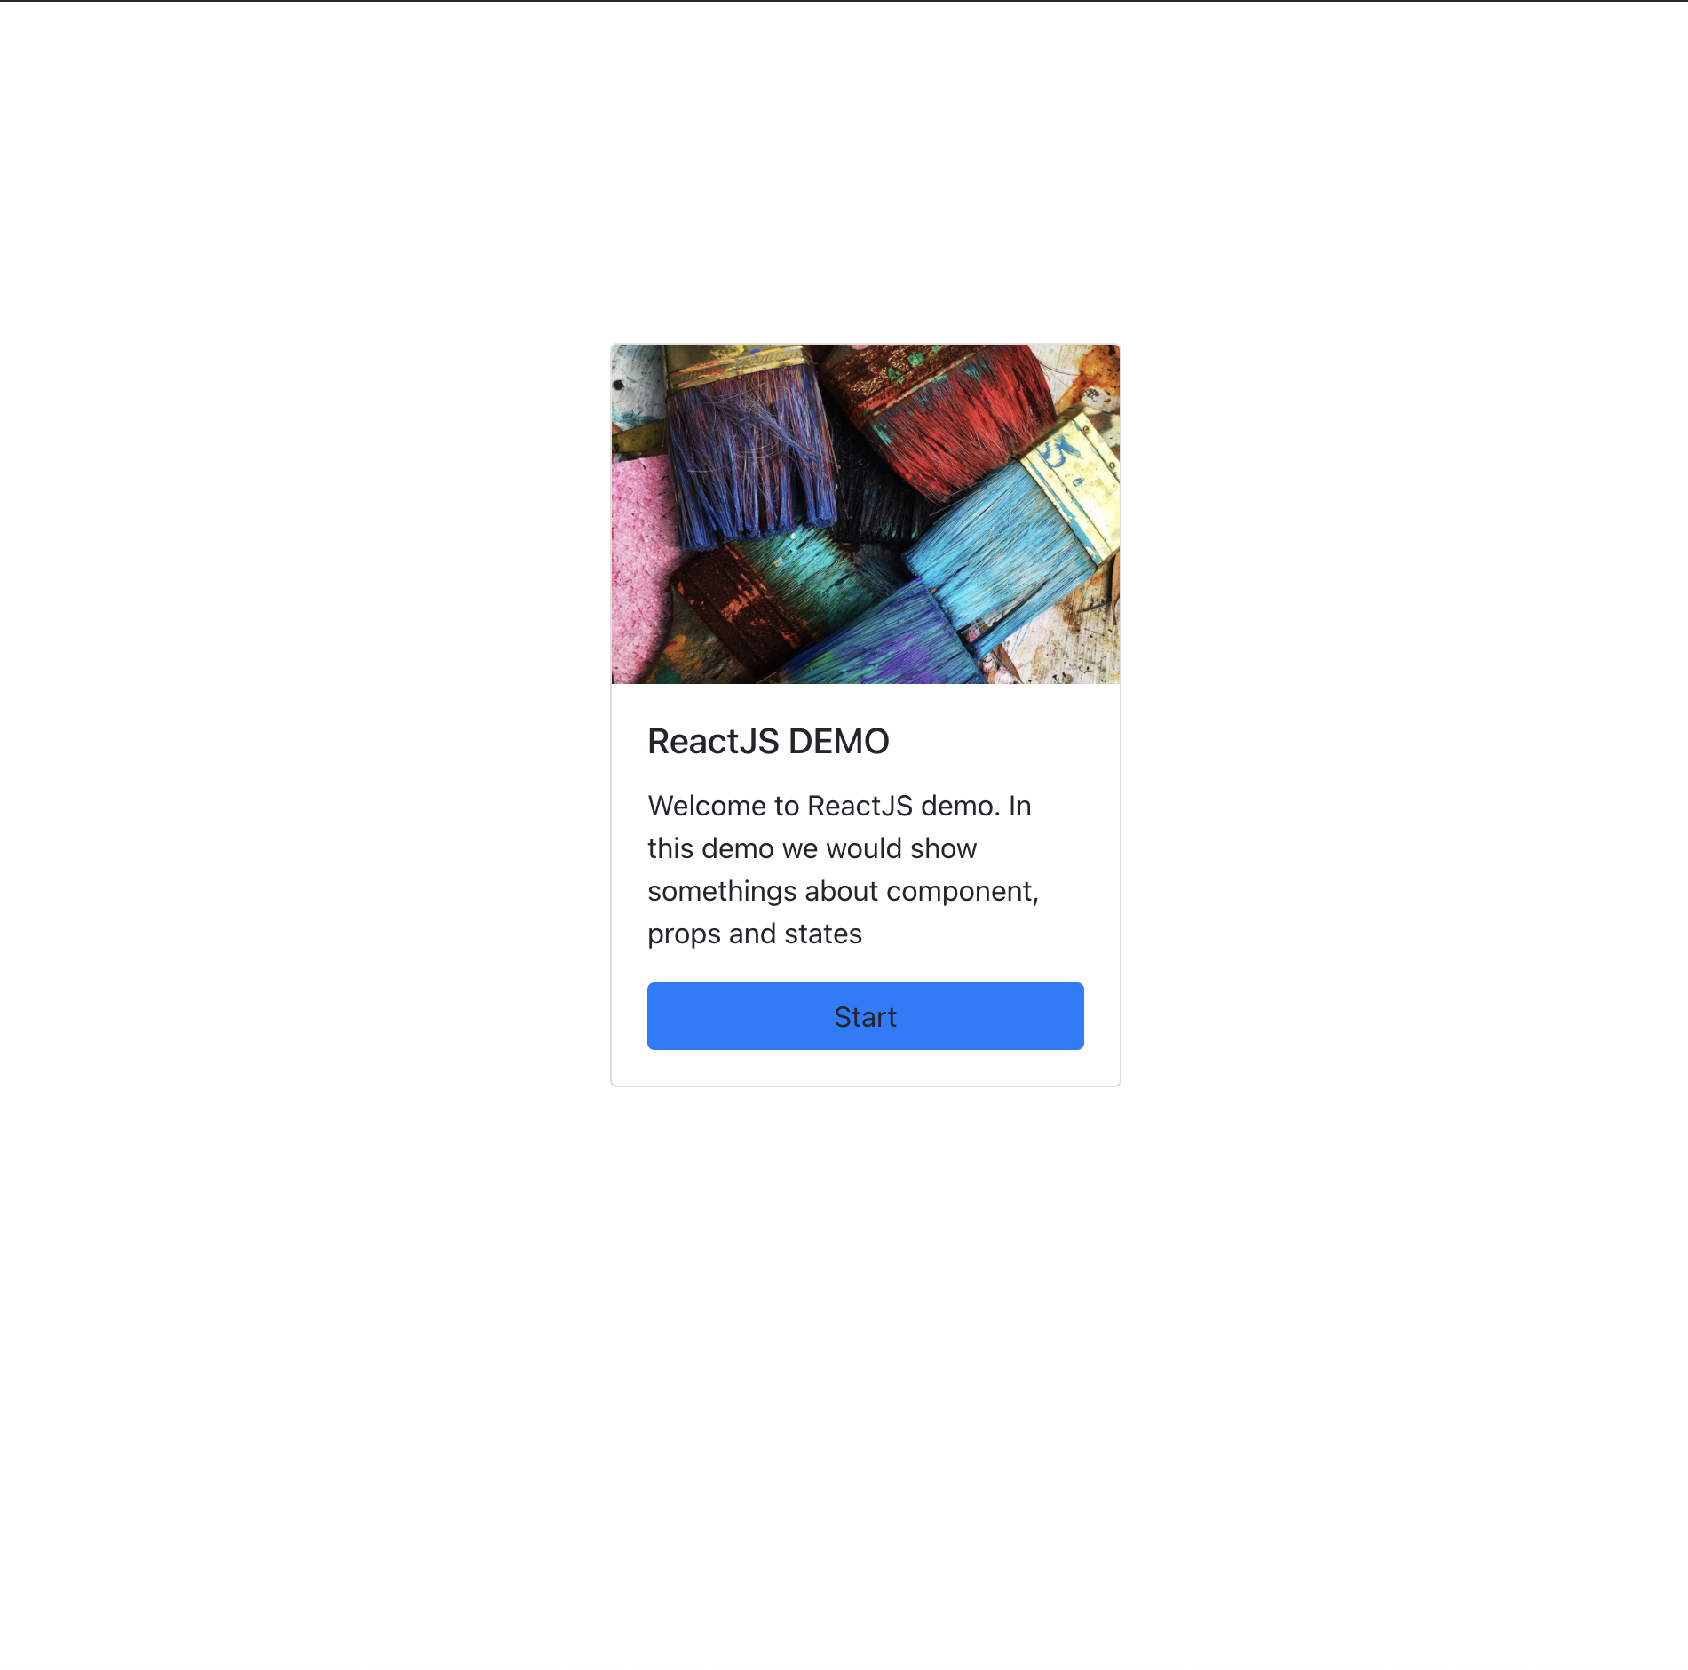
Demo
6. We could render the card into the main page by simply adding Card component
Into the render function of the Mainpage

Slide 14
Demo
7. Now we are going to use state and prop to control the information flow in the application
States: Sate is the state of the component, and it stores the information of this component in current time
Props: Prop is something like the parameters which pass to children component from father component.

Slide 15
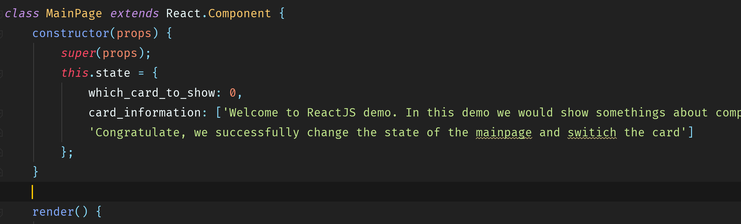
Demo
8. Let`s create states for MainPage
In the state, which card to show decide we would show one of the two cards in the main page. 0 means default, 1 means another one.
Card information stores data which is prepared to pass to two cards.

Slide 16
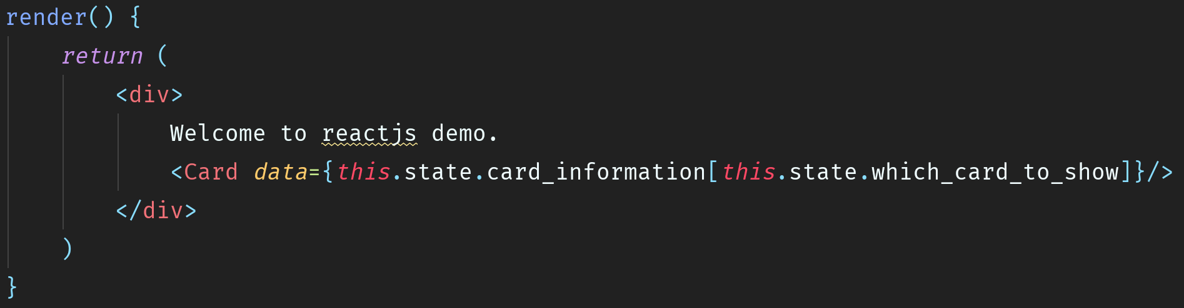
Demo
9. Now we could pass the data to cards

Slide 17
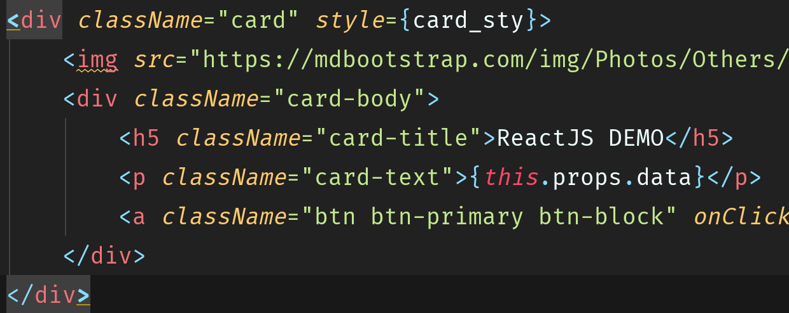
Demo
10. Then we load the data from props in card component. We could get same page as before.

Slide 18
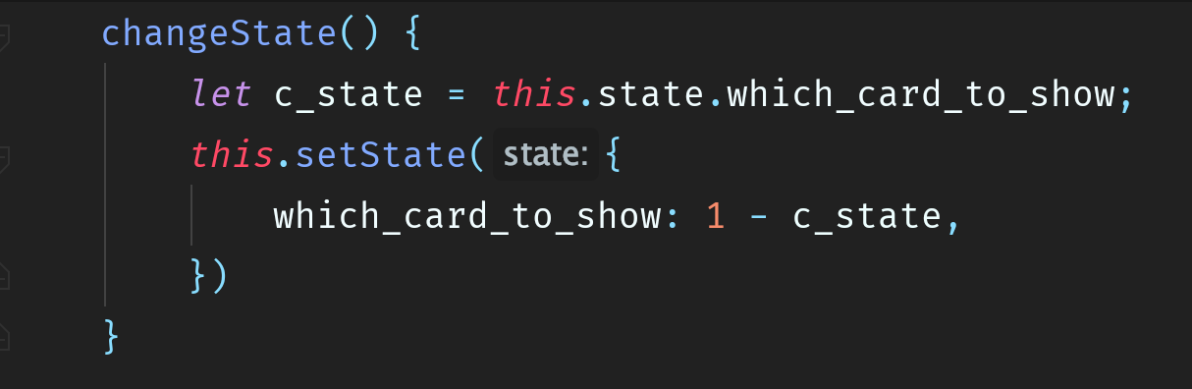
Demo
11. Then we need to pass the action event from the card component back to the parent component MainPage.
To achieve this, we need to pass a parameter, which is actually a state change function, to the card component, and call this function by event like button click.

Slide 19
Demo
12. Then we need to pass the action event from the card component back to the parent component MainPage.
To achieve this, we need to pass a parameter, which is actually a state change function, to the card component, and call this function by event like button click.
It`s important to use format like (m) => func(m) in props.

Slide 20
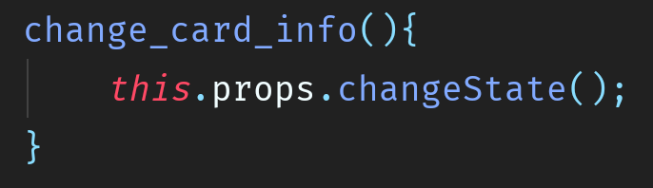
Demo
13. Then we could call the prop changeState in card component with button click

Slide 21
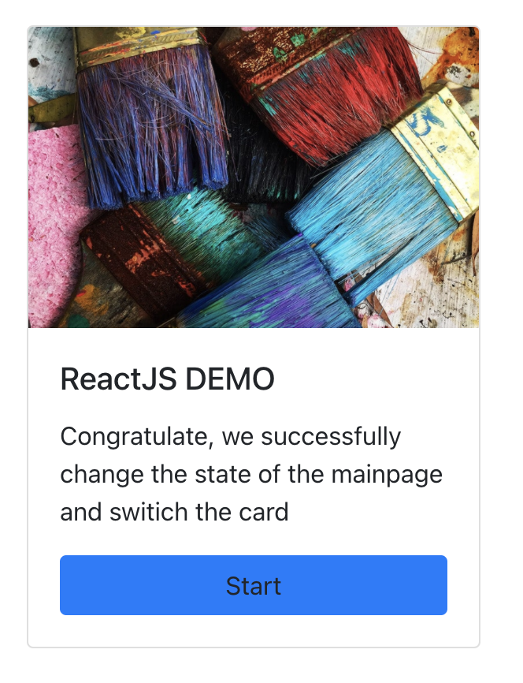
Demo
14. Let`s try it

Slide 22

THANKS

